Slide 1
Pet Health io
Isaiah Soung

Slide 2
Goals with the project
Learn IoT from a whole system perspective
Learn how to build a device
Very little knowledge on electrical engineering things
Have a good base to possibly build something cool for my own pets

Slide 3
Market: Outlook on Pet Health
Consumer spending increased from $13.7bn to $16bn, for pet health treatment, between 2012 and 2016.
Pet toy industry crossed the $1bn threshold in 2016.
The pet supply / pet health treatment industry has been growing and is continuing to grow.
Old fashion toys and supplies.
Lately newer, “smarter” toys are being made.

Slide 4
Market: Outlook on Pet Health
Not many toys for pets that are connected to the Internet and analyze data.
Many toys are being sold for higher prices because they are automated?
Toys that push a ball around
Toys that whip a string around automatically
But are they really automated? IoT?
Many pet supplies are connected to the internet
Petnet feeder
Laser pointer

Slide 5
Market: Appeal
A pet toy that doubles as an activity gauge. With a design that tries to entice the pet to play with the toy.
Easy to set up. Create an account online and enter in the serial number of the device to activate it.

Slide 6
Market: Appeal
Obesity
Can either put the pet on a diet or an exercise plan
Marketed as a pet toy that helps decrease vet bills
Increased risk for pet health problems if pet is overweight / obese.
Exercise intolerance, decreased stamina
Liver disease or dysfunction
Lowered immune system function
Increased risk of developing malignant tumors (cancer)

Slide 7
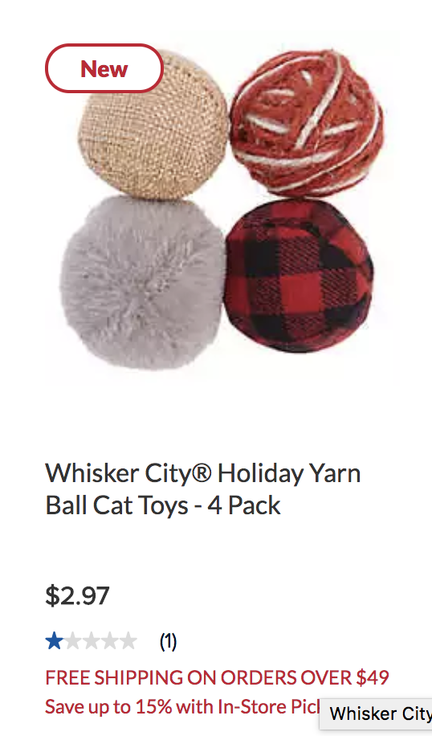
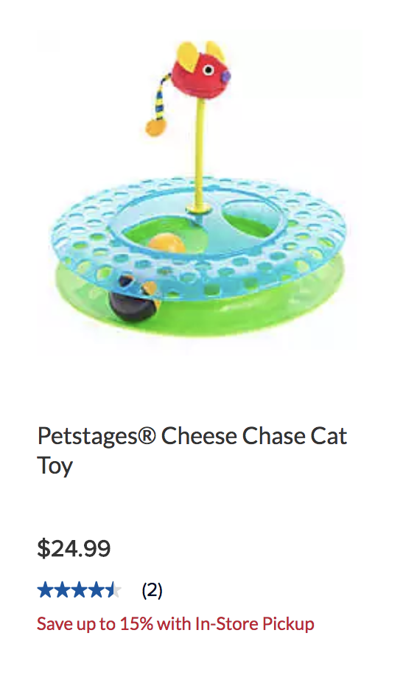
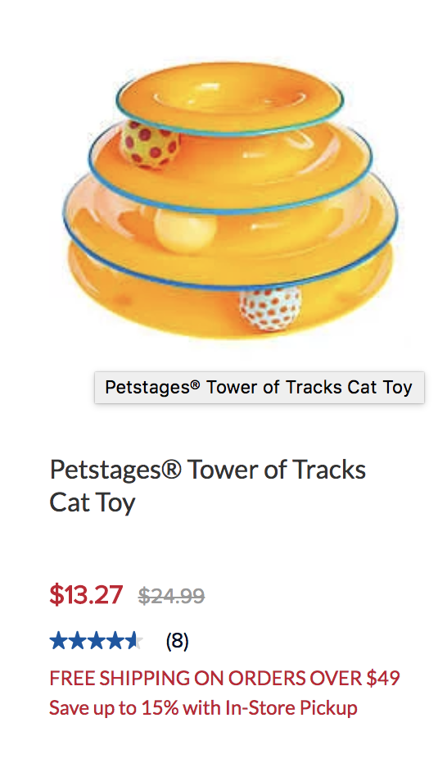
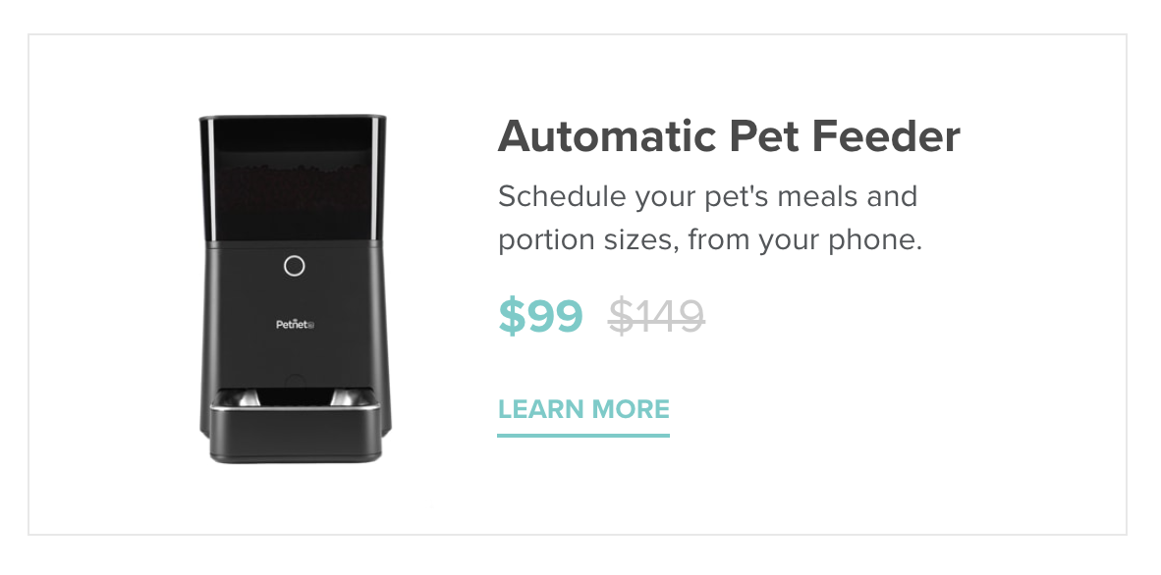
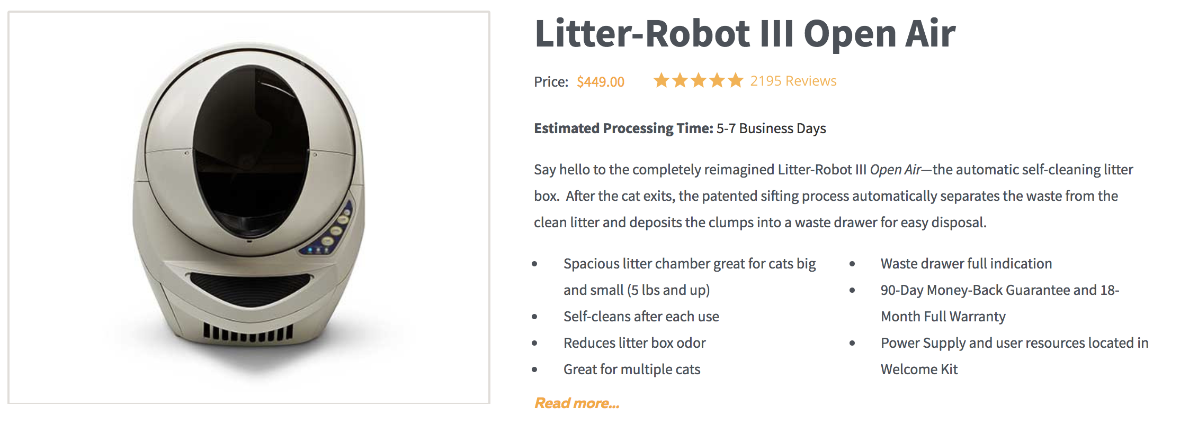
Market: Anecdotal Evidence
Anecdotal evidence, pet supplies can be expensive but if they provide some use many people will buy them.
Toys, some are cheap others can get more expensive.

Slide 8
Market: How will we market this to the over consumer base?
Fact is, people will pay for the convenience factor.
Having a toy that is a part of a system that can track activity level, notify you when activity levels are dropping, and help you correct that, is a huge convenience.
Especially taking into account pets that are obese.
Problem and Solution
No “smart” solutions for analyzing pet activity levels
Help pet owners have a convenient way to ”keep tabs” on their pet’s activity esp. when the pets are obese

Slide 9
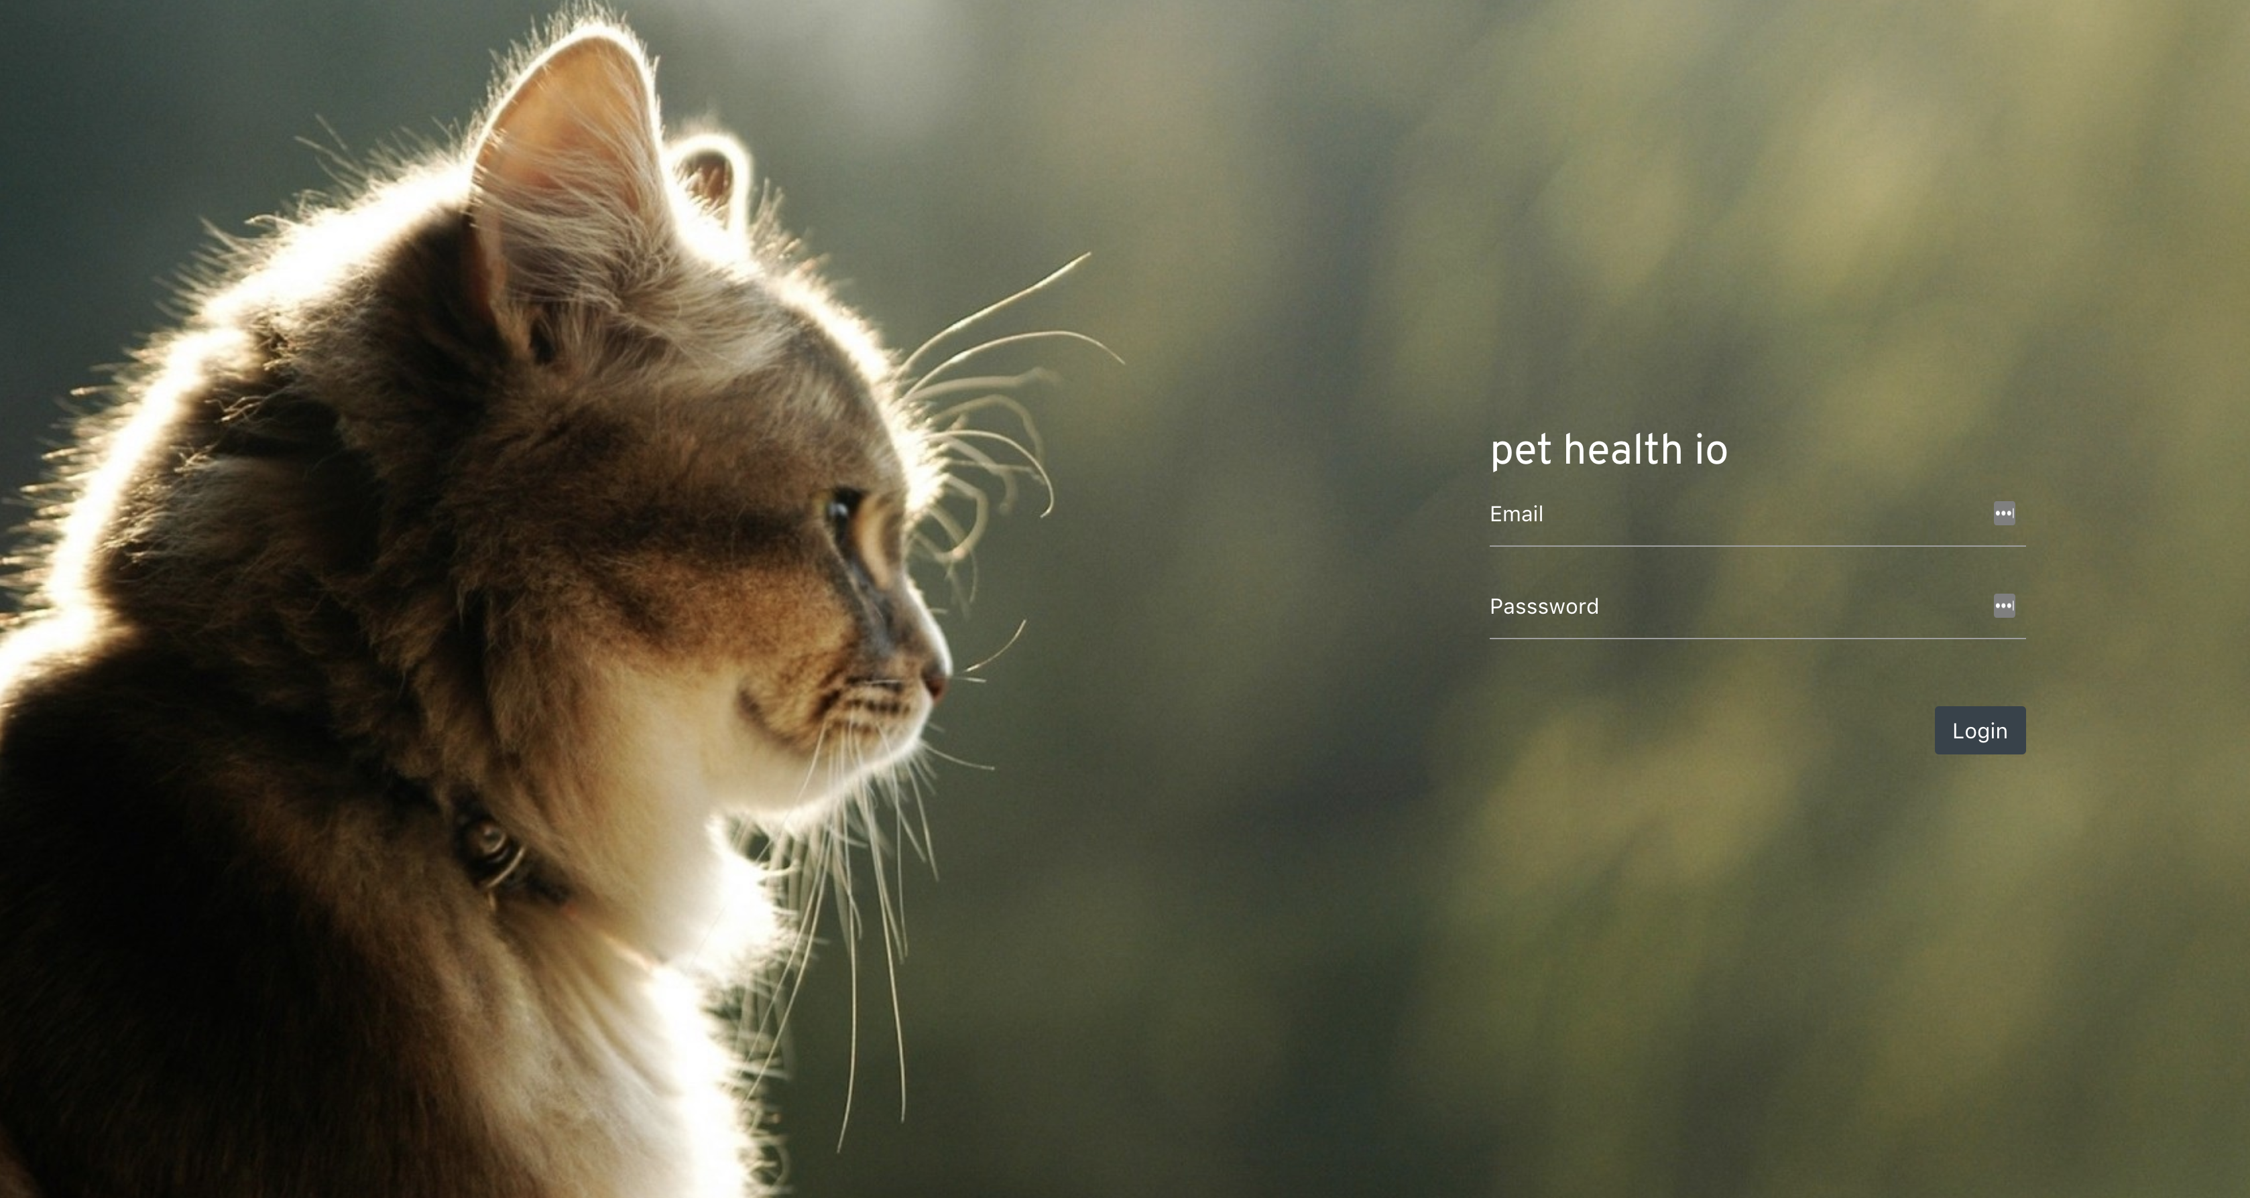
User Experience: Web Application
Pethealth.io login screen

Slide 10
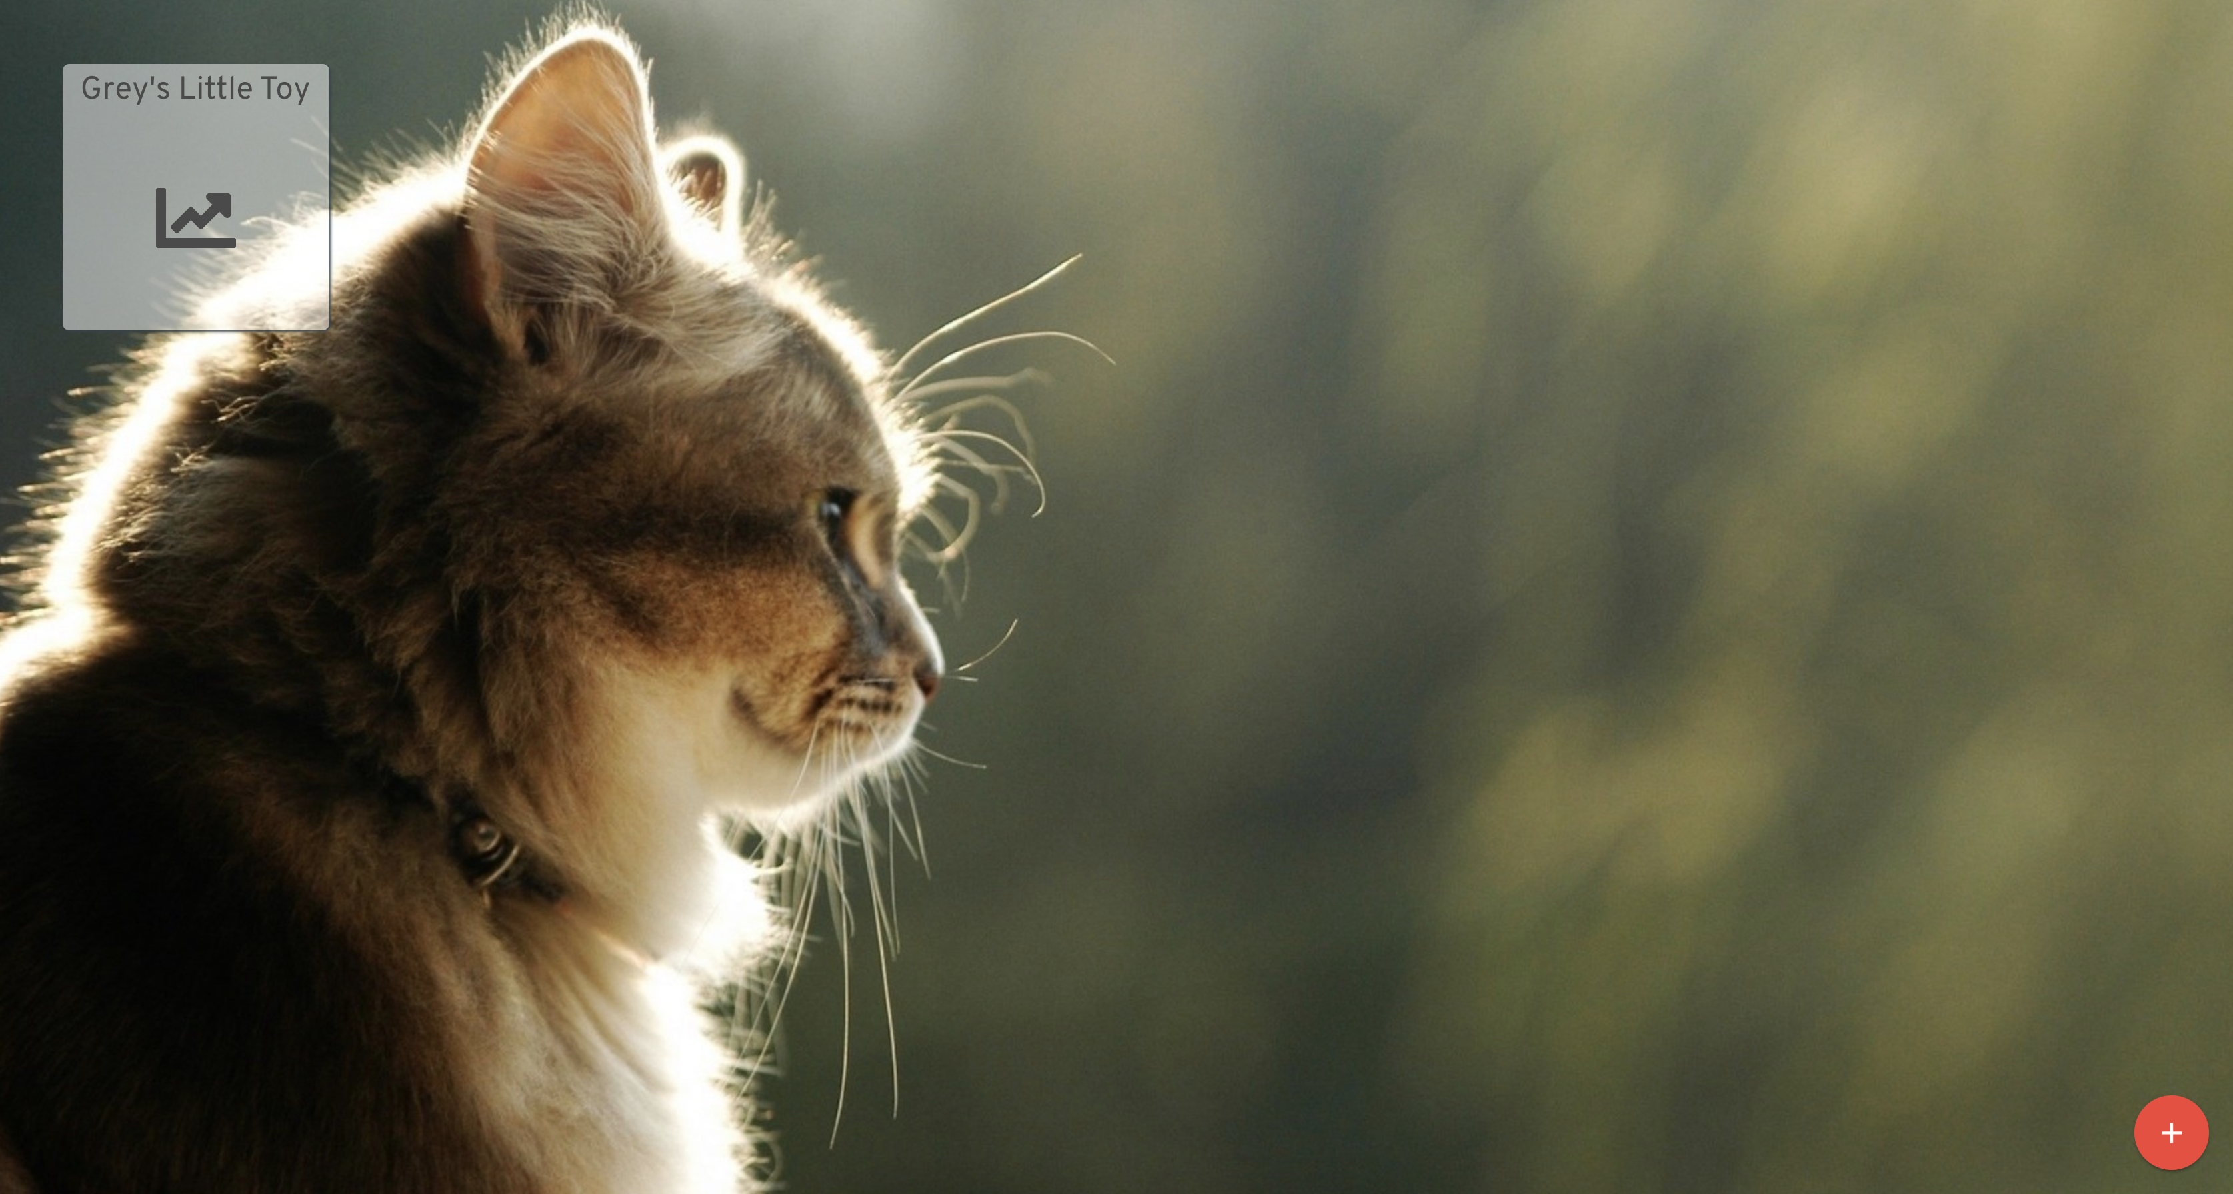
User Experience: Web Application
Pethealth.io dashboard

Slide 11
User Experience: Device
Device will be stored inside the device dependent on the form of the toy. I.E. Spherical toys will house the device meanwhile strings and the like will have the sensors applied to the strings.
Devices will come with serial numbers that will allow one to tie a device to a user.
Requires connection to a Wi-fi network in order to stream data
Device setup like the particle
Light based setup: Petnet
Hub based setup w/ BLE: Pet Health io V2

Slide 12
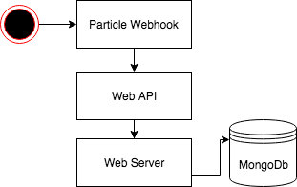
System Design
Particle does some computation to determine activity level.
Activity level is stored on a 10 second time interval. Every 10 seconds the particle device determines how many seconds of those 10 had any activity.
After every ten seconds data is sent to the particle webhook.

Slide 13
System Design
Particle webhook then sends an HTTP post request to the pethealth.io web API.
API is built using GraphQL which is different than the typical REST API.
Web server stores the data into a NoSQL data store, in this case we are using MongoDB.

Slide 14
System Design
Web Server will then send a notification via email, text message, or web desktop notification when there has been an set time with no activity.
Currently set to 10 seconds though ideally it would notify you once a day or every couple hours.

Slide 15
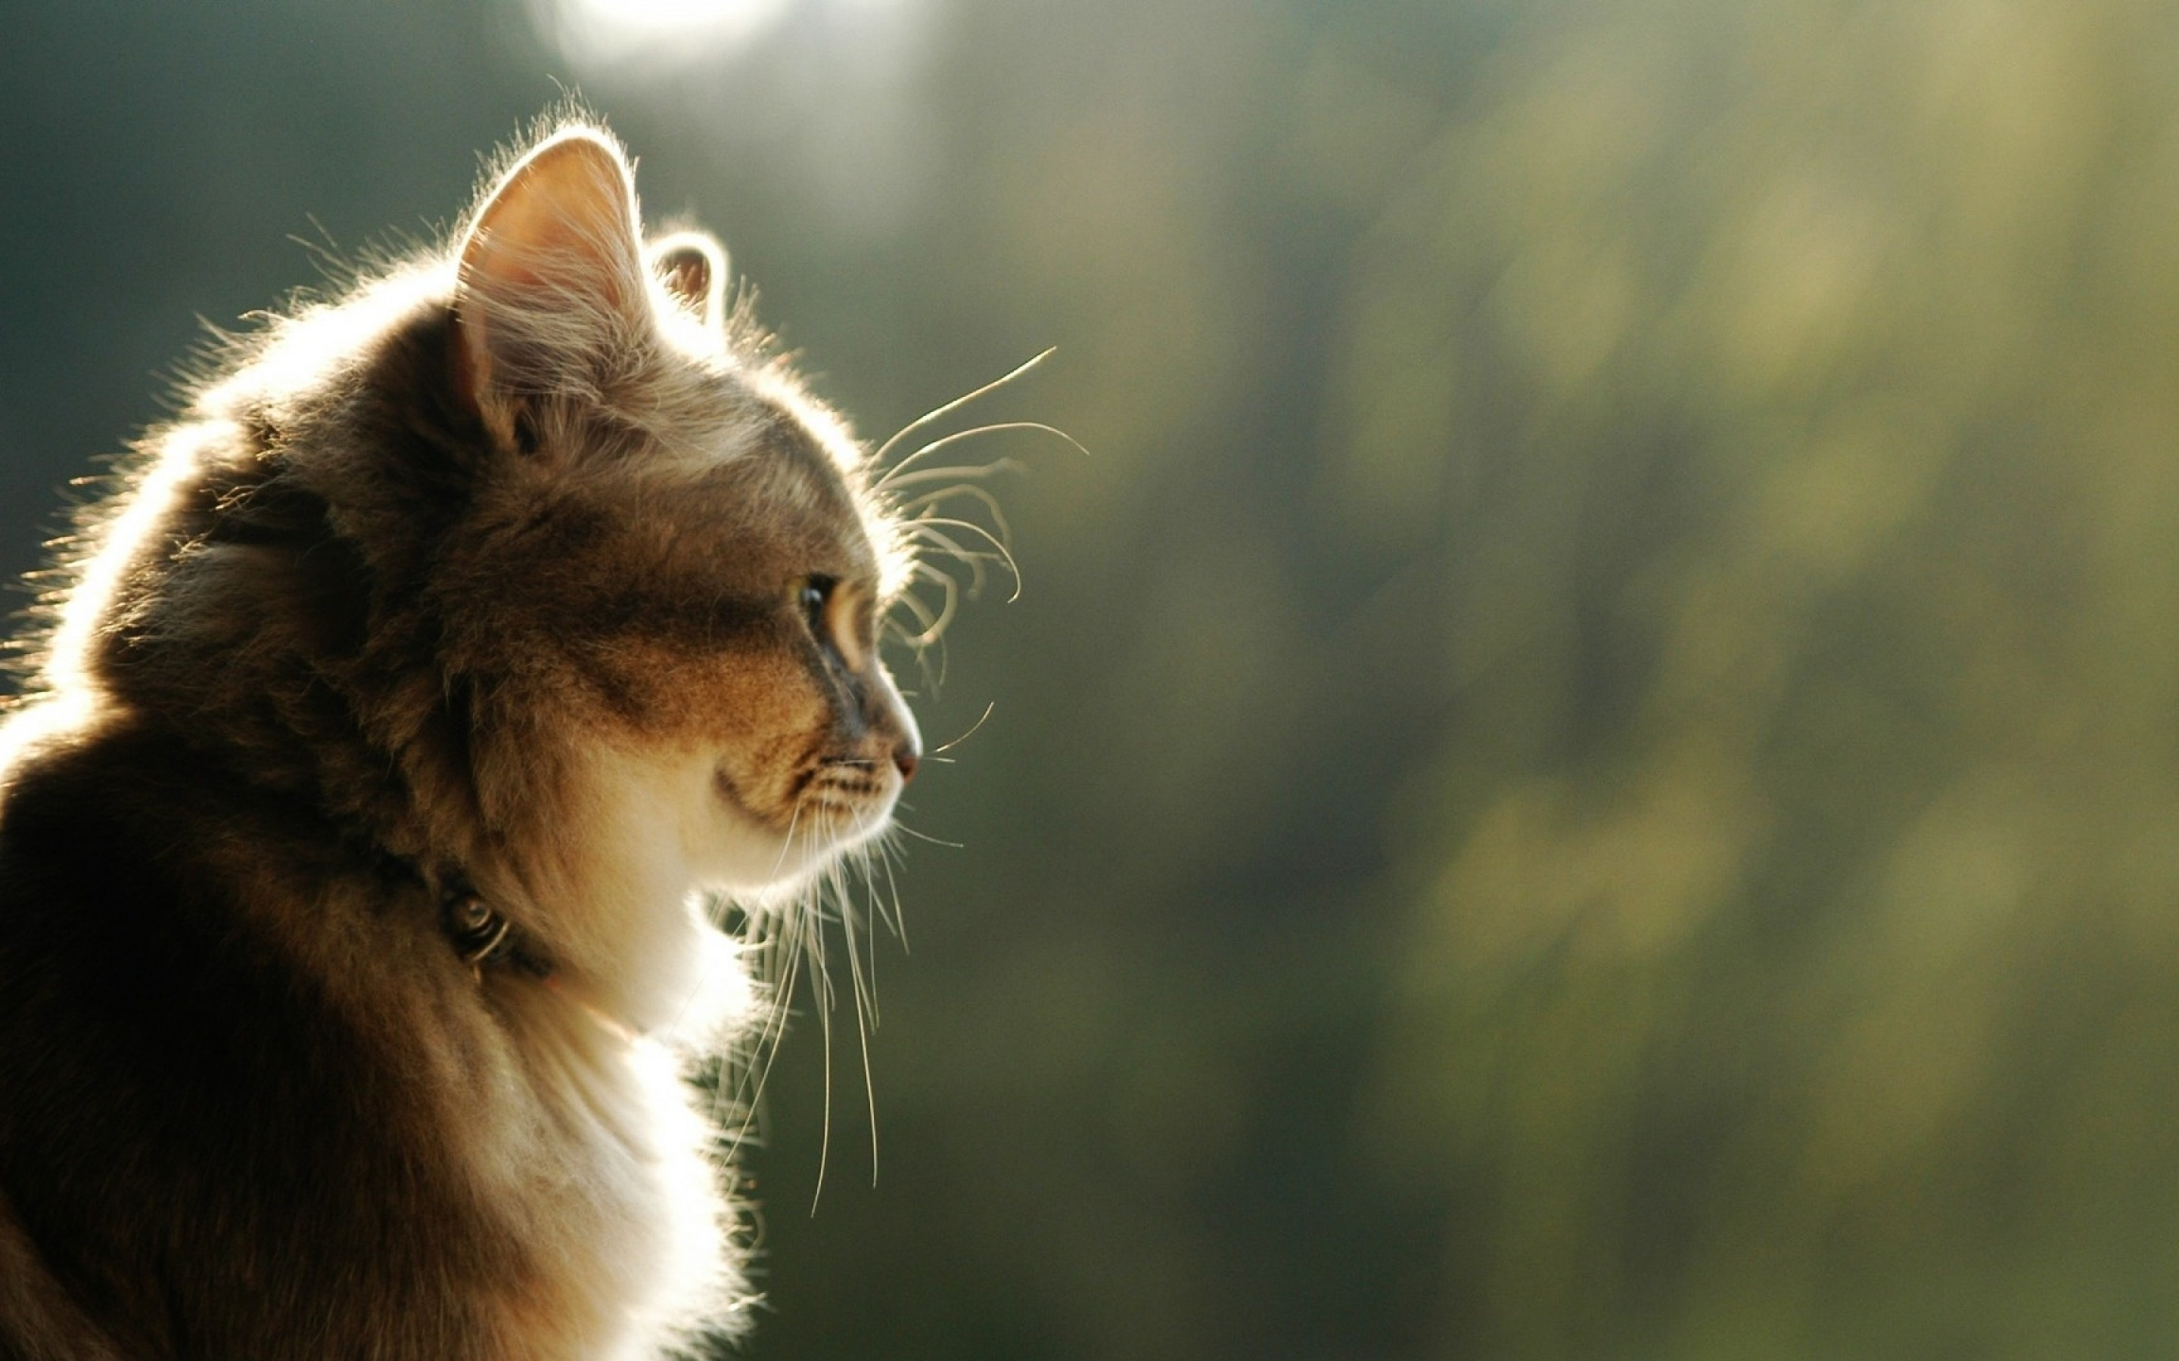
Demo!
4d004f000351353530373132
1. Create an account at pethealth.io
2. Enter your serial number above to create a new device
3. Click on the device and watch your pet’s activity

Slide 16
Improvements: V2.0
Create a hub where devices will communicate with. The hub would buffer/cache network requests if there was no internet connectivity or other settings.
Design toys to hold IoT device.
Better notification system.
Right now, system can’t scale to millions of users & millions of devices. It could probably handle thousands of devices & users.
Better web application UI

Slide 17
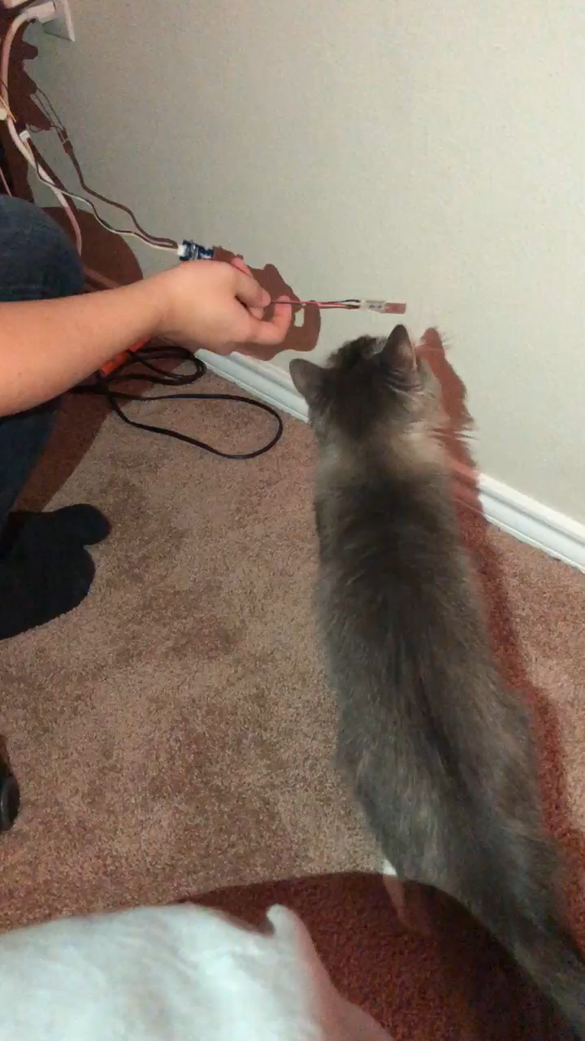
Improvements: V2.0
Make it more appealing to pets
Lights
Sounds
Vibrations
Cat nip?????

Slide 18
Kickstarter! Support Pet Health io!
https://www.kickstarter.com/projects/265997902/pet-health-iot-toy

Slide 19
Any Questions?
But for reals, I don’t have a kick starter so don’t go to the link and buy it… its not for the pet health io toy.

Slide 20
References
https://www.economist.com/news/business/21716077-shi-tzus-having-hip-replacements-and-cats-underwater-treadmills-americas-booming-pet
https://www.petmd.com/dog/nutrition/evr_multi_long_term_effects_of_obesity_on_pets
https://www.prnewswire.com/news-releases/us-pet-toys-market-tops-1-billion-300495452.html
https://www.petsmart.com
https://www.litter-robot.com
https://petnet.io/

